Slide 1
Cache Memories Introduction to Computer Systems 13th Lecture, Nov. 1, 2021
Instructors:
Class 1: Chen Xiangqun, Sun Guangyu , Liu Xianhua
Class 2: Guan Xuetao
Class 3: Lu Junlin

Slide 2
Today
Cache memory organization and operation
Performance impact of caches
The memory mountain
Rearranging loops to improve spatial locality
Using blocking to improve temporal locality

Slide 3
Recall: Locality
Principle of Locality: Programs tend to use data and instructions with addresses near or equal to those they have used recently
Temporal locality:
Recently referenced items are likely to be referenced again in the near future
Spatial locality:
Items with nearby addresses tend to be referenced close together in time

Slide 4
Recall: Modern CPU Design
Instruction Control
Fetch
Control
Address
Instruction
Cache
Retirement
Unit
Register
File
Instruction
Decode
Instructions
Operations
Register Updates
Prediction OK?
Execution
Functional
Units
Branch
Arith
Arith
Arith
Load
Store
Operation Results
Addr.
Addr.
Data
Data
Data
Cache

Slide 5
Recall: Locality Example
sum = 0;
for (i = 0; i < n; i++)
sum += a[i];
return sum;
Data references
Reference array elements in succession (stride-k reference pattern, k = 1).
Reference variable sum each iteration.
Instruction references
Reference instructions in sequence.
Cycle through loop repeatedly.
Spatial locality
Temporal locality
Spatial locality
Temporal locality

Slide 6

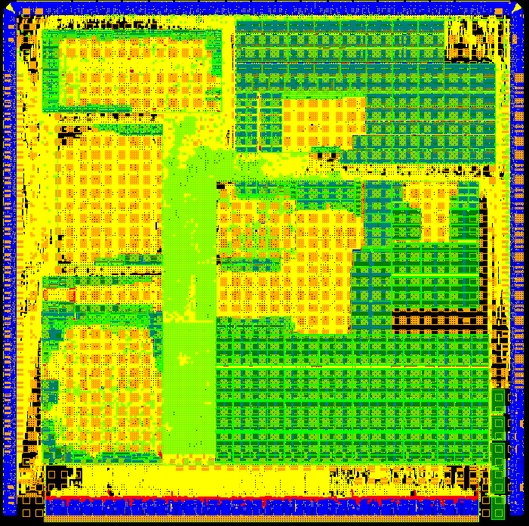


Recall: Memory Hierarchy
★ | ☆ |  | ☆
☆ | ★ | ☆ | ☆
☆ | ★ | ☆ | ☆
☆ | ★ | ☆ | ☆
☆ | ☆ | ★ | ☆
 |  | ★ | ☆
 |  | ★ | ☆
L0:
Regs
Smaller,
faster,
and
costlier
(per byte)
storage
devices
CPU registers hold words retrieved from the L1 cache.
L1:
L1 cache
(SRAM)
L1 cache holds cache lines retrieved from the L2 cache.
L2:
L2 cache
(SRAM)
L2 cache holds cache lines
retrieved from L3 cache
L3:
L3 cache
(SRAM)
L3 cache holds cache lines
retrieved from main memory.
Larger,
slower,
and
cheaper
(per byte)
storage
devices
L4:
Main memory
(DRAM)
Main memory holds disk blocks retrieved from local disks.
L5:
Local secondary storage
(local disks)
Local disks hold files retrieved from disks on remote servers
L6:
Remote secondary storage
(e.g., Web servers)

Slide 7
Recall: Examples of Caching in the Mem. Hierarchy
Cache Type
What is Cached?
Where is it Cached?
Latency (cycles)
Managed By
Registers
4-8 bytes words
CPU core
0
Compiler
TLB
Address translations
On-Chip TLB
0
Hardware MMU
L1 cache
64-byte blocks
On-Chip L1
4
Hardware
L2 cache
64-byte blocks
On-Chip L2
10
Hardware
Virtual Memory
4-KB pages
Main memory
100
Hardware + OS
Buffer cache
Parts of files
Main memory
100
OS
Disk cache
Disk sectors
Disk controller
100,000
Disk firmware
Network buffer cache
Parts of files
Local disk
10,000,000
NFS client
Browser cache
Web pages
Local disk
10,000,000
Web browser
Web cache
Web pages
Remote server disks
1,000,000,000
Web proxy server

Slide 8

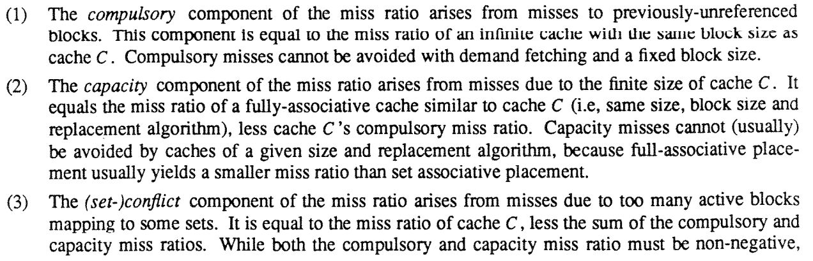
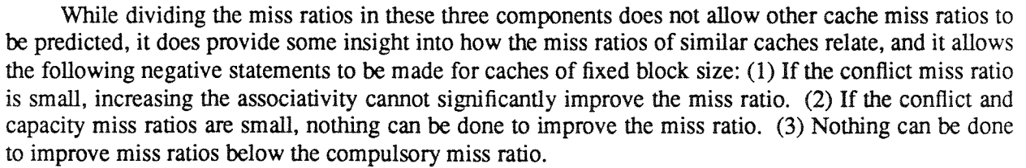
Recall: General Caching Concepts: 3 Types of Cache Misses
Cold (compulsory) miss
Cold misses occur because the cache starts empty and this is the first reference to the block.
Capacity miss
Occurs when the set of active cache blocks (working set) is larger than the cache.
Conflict miss
Most caches limit blocks at level k+1 to a small subset (sometimes a singleton) of the block positions at level k.
E.g. Block i at level k+1 must be placed in block (i mod 4) at level k.
Conflict misses occur when the level k cache is large enough, but multiple data objects all map to the same level k block.
E.g. Referencing blocks 0, 8, 0, 8, 0, 8, ... would miss every time.

Slide 9
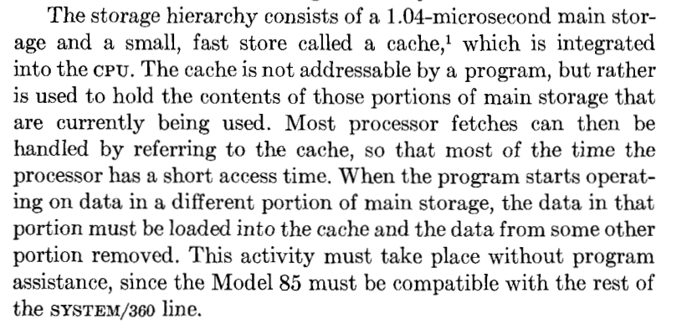
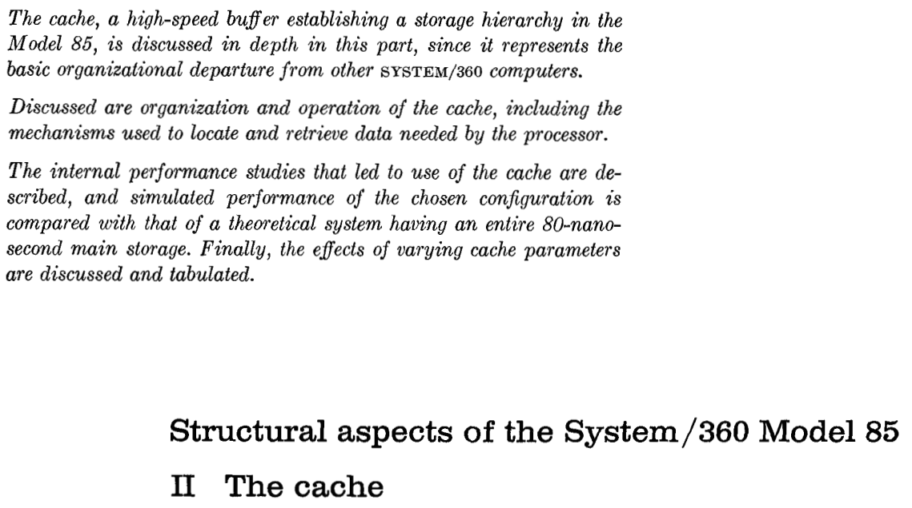
Cache Memories

Slide 10
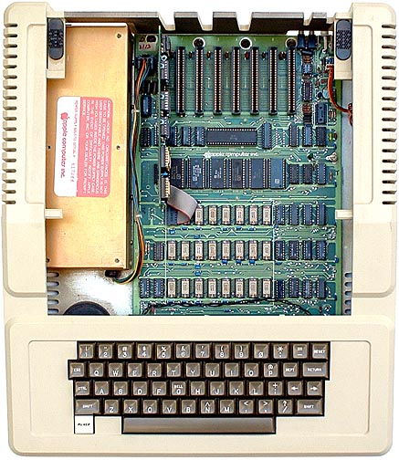
Cache Memories
Cache memories are small, fast SRAM-based memories managed automatically in hardware
Hold frequently accessed blocks of main memory
CPU looks first for data in cache
Typical system structure:
CPU chip
Early Apple (1977)
CPU: 1000ns DRAM: 400ns
Register file
ALU
Cache
memory
System bus
Memory bus
Main
memory
Bus interface
I/O
bridge

Slide 11
General Cache Organization (S, E, B)
E = 2e lines per set
set
line
S = 2^{s} sets
Cache size:
C = S x E x B data bytes
v
tag
0
1
2
B-1
valid bit
B = 2^{b} bytes per cache block (the data)

Slide 12
Cache Read
Locate set
Check if any line in set has matching tag
Yes + line valid: hit
Locate data starting at offset
E = 2e lines per set
Address of word:
t bits
s bits
b bits
S = 2^{s} sets
tag
set
index
block
offset
data begins at this offset
v
tag
0
1
2
B-1
valid bit
B = 2^{b} bytes per cache block (the data)

Slide 13
Example: Direct Mapped Cache (E = 1)
Direct mapped: One line per set
Assume: cache block size 8 bytes
Address:
v
tag
0
1
2
3
4
5
6
7
t bits
0…01
100
v
tag
0
1
2
3
4
5
6
7
find set
S = 2^{s} sets
v
tag
0
1
2
3
4
5
6
7
v
tag
0
1
2
3
4
5
6
7

Slide 14
Example: Direct Mapped Cache (E = 1)
Direct mapped: One line per set
Assume: cache block size 8 bytes
Address:
valid? +
match: assume yes = hit
t bits
0…01
100
v
tag
0
1
2
3
4
5
6
7
tag
block offset

Slide 15
Example: Direct Mapped Cache (E = 1)
Direct mapped: One line per set
Assume: cache block size 8 bytes
Address:
valid? +
match: assume yes = hit
t bits
0…01
100
v
tag
0
1
2
3
4
5
6
7
block offset
If the data type is int (4 Bytes) , it is here
If tag doesn’t match: old line is evicted and replaced

Slide 16
Direct-Mapped Cache Simulation
t=1
s=2
b=1
4-bit addresses (address space size M=16 bytes)
S=4 sets, E=1 Blocks/set, B=2 bytes/block
Address trace (reads, one byte per read):
0 [0000₂],
1 [0001₂],
7 [0111₂],
8 [1000₂],
0 [0000₂]
x
xx
x
miss
hit
miss
miss
miss
v
Tag
Block
Set 0
1
0
M[0-1]
0
0
M[0-1]
1
1
M[8-9]
Set 1
0
Set 2
0
Set 3
1
0
M[6-7]
0

Slide 17
E-way Set Associative Cache (Here: E = 2)
E = 2: Two lines per set
Assume: cache block size 8 bytes
Address of short int:
t bits
0…01
100
v
tag
0
1
2
3
4
5
6
7
v
tag
0
1
2
3
4
5
6
7
v
tag
0
1
2
3
4
5
6
7
v
tag
0
1
2
3
4
5
6
7
find set
v
tag
0
1
2
3
4
5
6
7
v
tag
0
1
2
3
4
5
6
7
v
tag
0
1
2
3
4
5
6
7
v
tag
0
1
2
3
4
5
6
7

Slide 18
E-way Set Associative Cache (Here: E = 2)
E = 2: Two lines per set
Assume: cache block size 8 bytes
Address of short int:
compare both
t bits
0…01
100
valid? +
match: yes = hit
v
tag
0
1
2
3
4
5
6
7
tag
v
tag
0
1
2
3
4
5
6
7
block offset

Slide 19
E-way Set Associative Cache (Here: E = 2)
E = 2: Two lines per set
Assume: cache block size 8 bytes
Address of short int:
compare both
t bits
0…01
100
valid? +
match: yes = hit
v
tag
0
1
2
3
4
5
6
7
v
tag
0
1
2
3
4
5
6
7
block offset
short int (2 Bytes) is here
No match:
One line in set is selected for eviction and replacement
Replacement policies: random, least recently used (LRU), …

Slide 20
2-Way Set Associative Cache Simulation
t=2
s=1
b=1
xx
x
x
4-bit addresses (M=16 bytes)
S=2 sets, E=2 blocks/set, B=2 bytes/block
Address trace (reads, one byte per read):
0 [0000₂],
1 [0001₂],
7 [0111₂],
8 [1000₂],
0 [0000₂]
miss
hit
miss
miss
hit
v
Tag
Block
1
00
M[0-1]
Set 0
0
1
10
M[8-9]
0
1
01
M[6-7]
Set 1
0
0

Slide 21
What about writes?
Multiple copies of data exist:
L1, L2, L3, Main Memory, Disk
What to do on a write-hit?
Write-through (write immediately to memory)
Write-back (defer write to memory until replacement of line)
Each cache line needs a dirty bit (set if data has been written to)
What to do on a write-miss?
Write-allocate (load into cache, update line in cache)
Good if more writes to the location will follow
No-write-allocate (writes straight to memory, does not load into cache)
Typical
Write-through + No-write-allocate
Write-back + Write-allocate （recommend for programmers)
v
d
tag
0
1
2
B-1
valid bit
dirty bit
B = 2^{b} bytes

Slide 22
Practical Write-back Write-allocate
v
d
tag
0
1
2
B-1
A write to address X is issued
If it is a hit
Update the contents of block
Set dirty bit to 1 (bit is sticky and only cleared on eviction)
If it is a miss
Fetch block from memory (per a read miss)
The perform the write operations (per a write hit)
If a line is evicted and dirty bit is set to 1
The entire block of 2^{b} bytes are written back to memory
Dirty bit is cleared (set to 0)
Line is replaced by new contents
valid bit
dirty bit
B = 2^{b} bytes

Slide 23
Why Index Using Middle Bits?
Direct mapped: One line per set
Assume: cache block size 8 bytes
Standard Method:
Middle bit indexing
Address of int:
v
tag
0
1
2
3
4
5
6
7
t bits
0…01
100
v
tag
0
1
2
3
4
5
6
7
find set
S = 2^{s} sets
v
tag
0
1
2
3
4
5
6
7
Alternative Method:
High bit indexing
Address of int:
v
tag
0
1
2
3
4
5
6
7
1…11
t bits
100
find set

Slide 24
Illustration of Indexing Approaches
0000xx
0001xx
0010xx
64-byte memory
6-bit addresses
16 byte, direct-mapped cache
Block size = 4. (Thus, 4 sets; why?)
2 bits tag, 2 bits index, 2 bits offset
0011xx
0100xx
0101xx
0110xx
0111xx
1000xx
1001xx
Set 0
1010xx
Set 1
1011xx
Set 2
1100xx
Set 3
1101xx
1110xx
1111xx

Slide 25
Middle Bit Indexing
0000xx
0001xx
0010xx
Addresses of form TTSSBB
TT Tag bits
SS Set index bits
BB Offset bits
Makes good use of spatial locality
0011xx
0100xx
0101xx
0110xx
0111xx
1000xx
1001xx
Set 0
1010xx
Set 1
1011xx
Set 2
1100xx
Set 3
1101xx
1110xx
1111xx

Slide 26
High Bit Indexing
0000xx
0001xx
0010xx
Addresses of form SSTTBB
SS Set index bits
TT Tag bits
BB Offset bits
Program with high spatial locality would generate lots of conflicts
0011xx
0100xx
0101xx
0110xx
0111xx
1000xx
1001xx
Set 0
1010xx
Set 1
1011xx
Set 2
1100xx
Set 3
1101xx
1110xx
1111xx

Slide 27
Intel Core i7 Cache Hierarchy
Processor package
Core 0
Core 3
L1 i-cache and d-cache:
32 kB, 8-way,
Access: 4 cycles
L2 unified cache:
256 kB, 8-way,
Access: 10 cycles
L3 unified cache:
8 MB, 16-way,
Access: 40-75 cycles
Block size: 64 bytes for all caches.
Regs
Regs
L1
d-cache
L1
i-cache
L1
d-cache
L1
i-cache
…
L2 unified cache
L2 unified cache
L3 unified cache
(shared by all cores)
Main memory

Slide 28
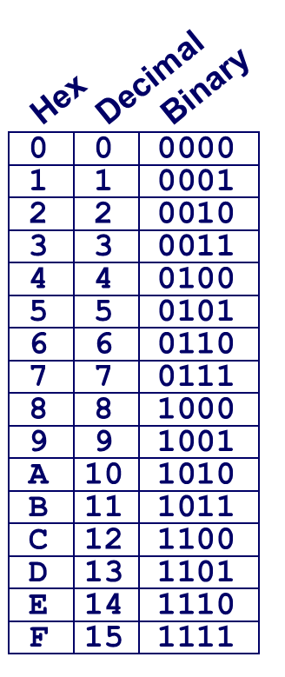
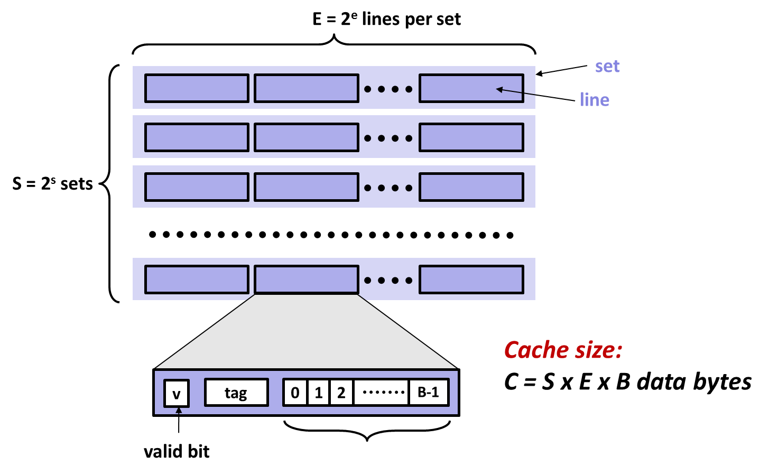
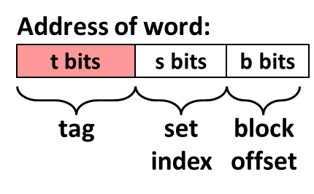
Example: Core i7 L1 Data Cache
32 KB 8-way set associative
64 bytes/block
LRU/Write alloc/Write back
47 bit address range
B =
S = , s =
E = , e =
C =
Stack Address: 0x00007f7262a1e010
Block offset: 0x??
Set index: 0x??
Tag: 0x??
Block offset: . bits
Set index: . bits
Tag: . bits

Slide 29
Example: Core i7 L1 Data Cache
32 KB 8-way set associative 64 bytes/block
LRU/Write alloc/Write back
47 bit address range
B = 64
S = 64, s = 6
E = 8, e = 3
C = 64 x 64 x 8 = 32,768
Stack Address: 0x00007f7262a1e010
Block offset: 0x10
Set index: 0x0
Tag: 0x7f7262a1e
Block offset: 6 bits
Set index: 6 bits
Tag: 35 bits
0000 0001 0000

Slide 30
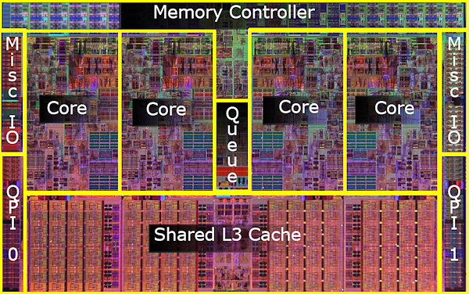
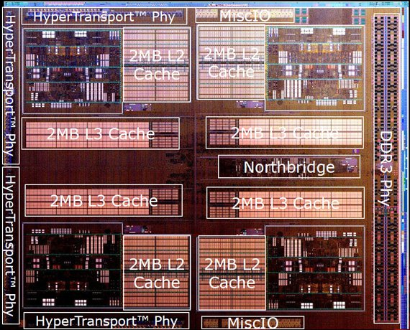
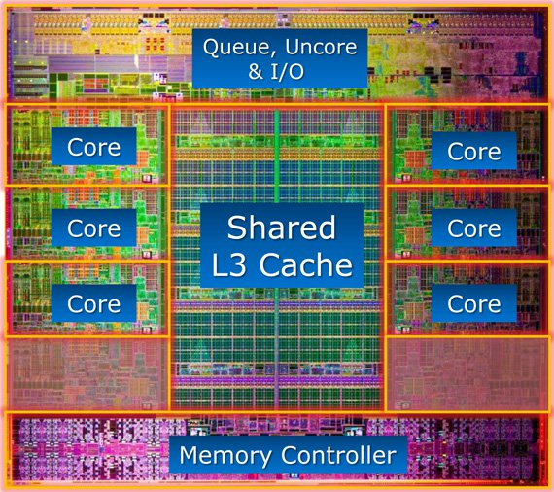
What it Really Looks Like
CPU chip
Register file
ALU
Cache
memory
Bus interface
Nehalem
AMD FX 8150
Core i7-3960X

Slide 31
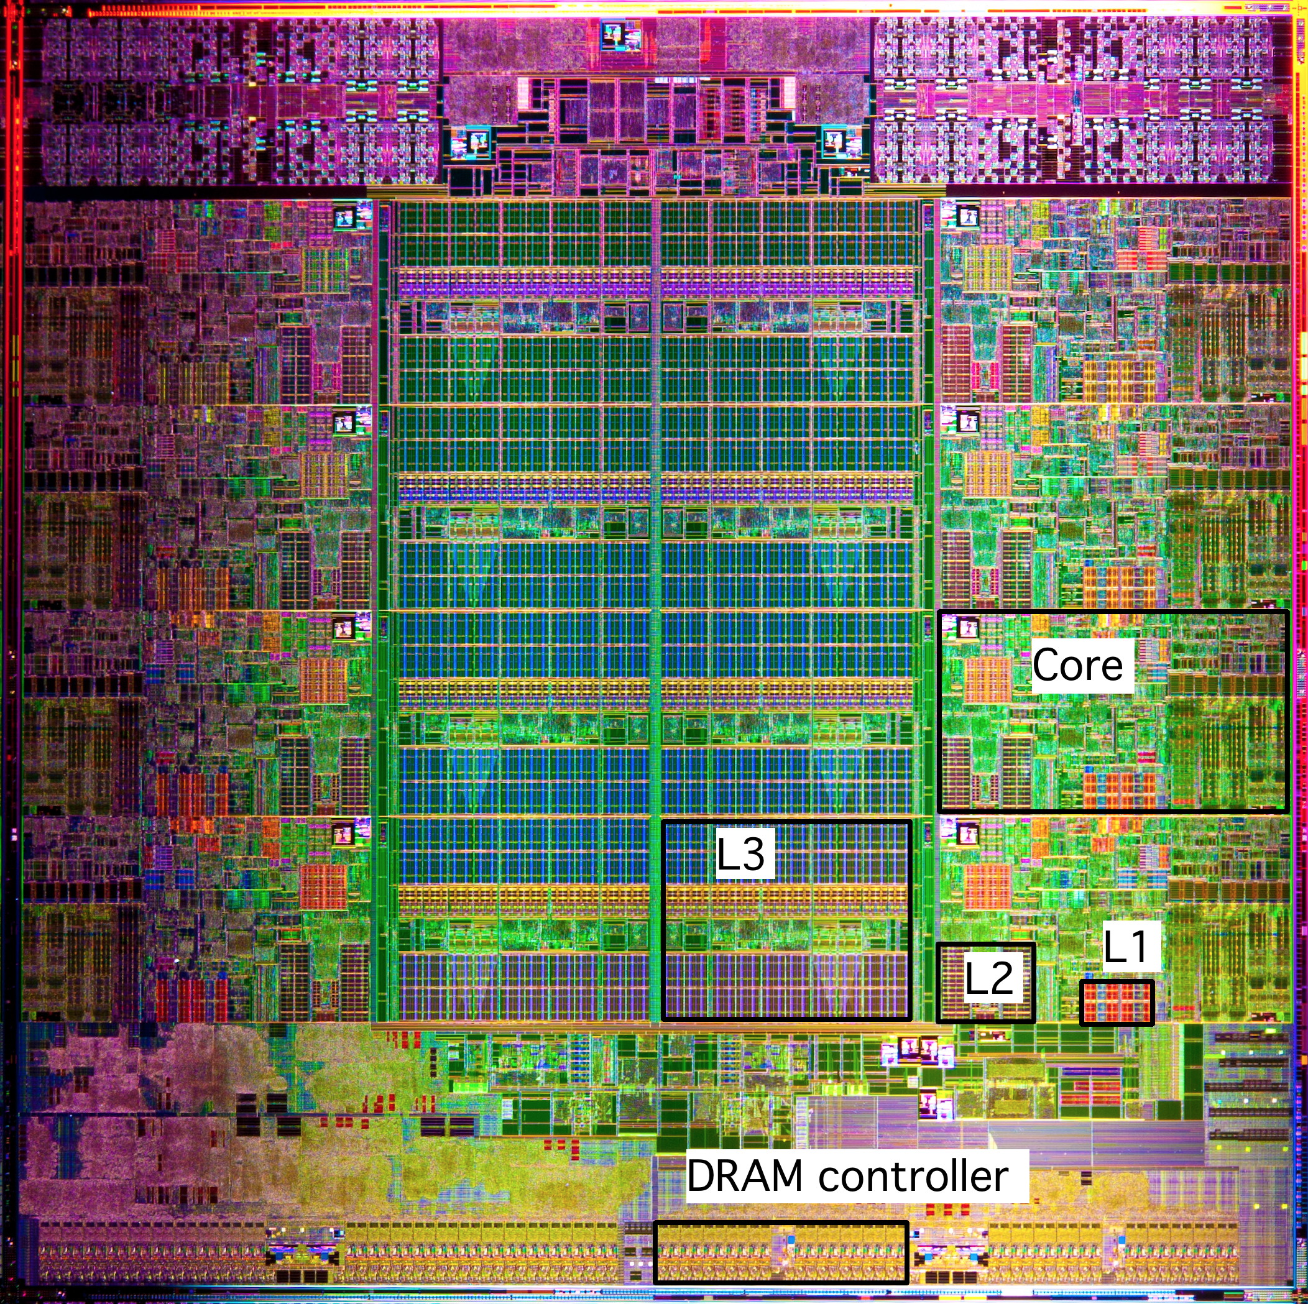
What it Really Looks Like (Cont.)
Intel Sandy Bridge
Processor Die
L1: 32KB Instruction + 32KB Data
L2: 256KB
L3: 3–20MB

Slide 32
Cache Performance Metrics
Miss Rate
Fraction of memory references not found in cache (misses / accesses) = 1 – hit rate
Typical numbers (in percentages):
3-10% for L1
can be quite small (e.g., < 1%) for L2, depending on size, etc.
Hit Time
Time to deliver a line in the cache to the processor
includes time to determine whether the line is in the cache
Typical numbers:
4 clock cycle for L1
10 clock cycles for L2
Miss Penalty
Additional time required because of a miss
typically 50-200 cycles for main memory (Trend: increasing!)

Slide 33
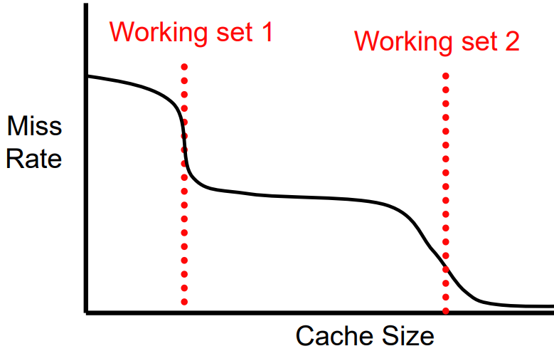
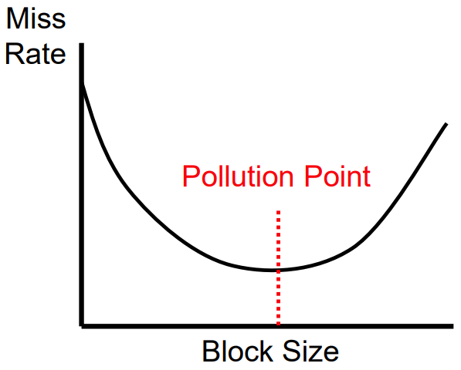
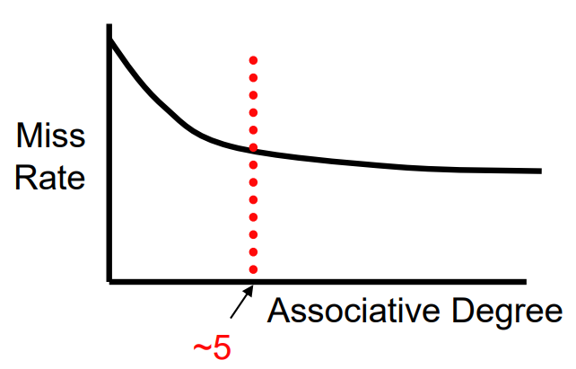
Cache Performance Metrics
Capacity
+ Decreases capacity misses
– Increases latency of hit.
Block size
– Increases conflict misses (fewer lines)
+ Decreases compulsory misses (spatial prefetching)
• No effect on latency of hit
May increase latency of miss
Associativity
+ Decreases conflict misses
– Increases latency of hit/miss

Slide 34
Let’s think about those numbers
Huge difference between a hit and a miss
Could be 100x, if just L1 and main memory
Would you believe 99% hits is twice as good as 97%?
Consider: cache hit time of 1 cycle miss penalty of 100 cycles
Average access time:
97% hits: 1 cycle + 0.03 * 100 cycles = 4 cycles
99% hits: 1 cycle + 0.01 * 100 cycles = 2 cycles
This is why “miss rate” is used instead of “hit rate”

Slide 35
Writing Cache Friendly Code
Make the common case go fast
Focus on the inner loops of the core functions
Minimize the misses in the inner loops
Repeated references to variables are good (temporal locality)
Stride-1 reference patterns are good (spatial locality)
Key idea: Our qualitative notion of locality is quantified through our understanding of cache memories

Slide 36
Today
Cache organization and operation
Performance impact of caches
The memory mountain
Rearranging loops to improve spatial locality
Using blocking to improve temporal locality

Slide 37
The Memory Mountain
Read throughput (read bandwidth)
Number of bytes read from memory per second (MB/s)
Memory mountain: Measured read throughput as a function of spatial and temporal locality.
Compact way to characterize memory system performance.

Slide 38
Memory Mountain Test Function
long data[MAXELEMS]; /* Global array to traverse */
/* test - Iterate over first "elems" elements of
* array “data” with stride of "stride", using
* using 4x4 loop unrolling.
*/
int test(int elems, int stride) {
long i, sx2=stride*2, sx3=stride*3, sx4=stride*4;
long acc0 = 0, acc1 = 0, acc2 = 0, acc3 = 0;
long length = elems, limit = length - sx4;
/* Combine 4 elements at a time */
for (i = 0; i < limit; i += sx4) {
acc0 = acc0 + data[i];
acc1 = acc1 + data[i+stride];
acc2 = acc2 + data[i+sx2];
acc3 = acc3 + data[i+sx3];
}
/* Finish any remaining elements */
for (; i < length; i++) {
acc0 = acc0 + data[i];
}
return ((acc0 + acc1) + (acc2 + acc3));
}
Call test() with many combinations of elems
and stride.
For each elems and stride:
1. Call test() once to warm up the caches.
2. Call test() again and measure the read throughput(MB/s)
mountain/mountain.c

Slide 39
The Memory Mountain
Core i7 Haswell
2.1 GHz
32 KB L1 d-cache
256 KB L2 cache
8 MB L3 cache
64 B block size
Aggressive prefetching
L1
Ridges
of temporal locality
L2
L3
Slopes
of spatial locality
Mem

Slide 40
Cache Capacity Effects from Memory Mountain
Core i7 Haswell
3.1 GHz
32 KB L1 d-cache
256 KB L2 cache
8 MB L3 cache
64 B block size
Main Memory
L3
L2
L1
Slice through memory mountain with stride=8

Slide 41
Cache Block Size Effects from Memory Mountain
Core i7 Haswell
2.26 GHz
32 KB L1 d-cache
256 KB L2 cache
8 MB L3 cache
64 B block size
Miss rate = s/8
Miss rate = 1.0
Stride s

Slide 42
Modeling Block Size Effects from Memory Mountain
Core i7 Haswell
2.26 GHz
32 KB L1 d-cache
256 KB L2 cache
8 MB L3 cache
64 B block size
Stride s

Slide 43
The Memory Mountain
Core i5 Haswell
3.1 GHz
32 KB L1 d-cache
256 KB L2 cache
8 MB L3 cache
64 B block size
Aggressive prefetching
L1
Ridges
of temporal locality
L2
L3
Slopes
of spatial locality
Mem

Slide 44
2008 Memory Mountain
Core 2 Duo
2.4 GHz
32 KB L1 d-cache
6MB L2 cache
64 B block size
No prefetching

Slide 45
Today
Cache organization and operation
Performance impact of caches
The memory mountain
Rearranging loops to improve spatial locality
Using blocking to improve temporal locality

Slide 46
Matrix Multiplication Example
Description:
Multiply N x N matrices
Matrix elements are doubles (8 bytes)
O(N³) total operations
N reads per source element
N values summed per destination
but may be able to hold in register
Variable sum
held in register
/* ijk */
for (i=0; i<n; i++) {
for (j=0; j<n; j++) {
sum = 0.0;
for (k=0; k<n; k++)
sum += a[i][k] * b[k][j];
c[i][j] = sum;
}
}
matmult/mm.c

Slide 47
Miss Rate Analysis for Matrix Multiply
Assume:
Block size = 32B (big enough for four doubles)
Matrix dimension (N) is very large
Approximate 1/N as 0.0
Cache is not even big enough to hold multiple rows
Analysis Method:
Look at access pattern of inner loop
j
=
k
x
j
i
i
k
C
A
B

Slide 48
Layout of C Arrays in Memory (review)
C arrays allocated in row-major order
each row in contiguous memory locations
Stepping through columns in one row:
for (i = 0; i < N; i++)
sum += a[0][i];
accesses successive elements
if block size (B) > sizeof(a_{ij}) bytes, exploit spatial locality
miss rate = sizeof(a_{ij}) / B
Stepping through rows in one column:
for (i = 0; i < n; i++)
sum += a[i][0];
accesses distant elements
no spatial locality!
miss rate = 1 (i.e. 100%)

Slide 49
Matrix Multiplication (ijk)
/* ijk */
for (i=0; i<n; i++) {
for (j=0; j<n; j++) {
sum = 0.0;
for (k=0; k<n; k++)
sum += a[i][k] * b[k][j];
c[i][j] = sum;
}
}
Inner loop:
(*,j)
(i,j)
(i,*)
A
B
C
matmult/mm.c
Row-wise
Column-
wise
Fixed
Misses per inner loop iteration:
A B C
0.25 1.0 0.0

Slide 50
Matrix Multiplication (jik)
/* jik */
for (j=0; j<n; j++) {
for (i=0; i<n; i++) {
sum = 0.0;
for (k=0; k<n; k++)
sum += a[i][k] * b[k][j];
c[i][j] = sum
}
}
Inner loop:
(*,j)
(i,j)
(i,*)
A
B
C
matmult/mm.c
Row-wise
Column-
wise
Fixed
Misses per inner loop iteration:
A B C
0.25 1.0 0.0

Slide 51
Matrix Multiplication (kij)
/* kij */
for (k=0; k<n; k++) {
for (i=0; i<n; i++) {
r = a[i][k];
for (j=0; j<n; j++)
c[i][j] += r * b[k][j];
}
}
Inner loop:
(i,k)
(k,*)
(i,*)
A
B
C
matmult/mm.c
Fixed
Row-wise
Row-wise
Misses per inner loop iteration:
A B C
0.0 0.25 0.25

Slide 52
Matrix Multiplication (ikj)
/* ikj */
for (i=0; i<n; i++) {
for (k=0; k<n; k++) {
r = a[i][k];
for (j=0; j<n; j++)
c[i][j] += r * b[k][j];
}
}
Inner loop:
(i,k)
(k,*)
(i,*)
A
B
C
matmult/mm.c
Fixed
Row-wise
Row-wise
Misses per inner loop iteration:
A B C
0.0 0.25 0.25

Slide 53
Matrix Multiplication (jki)
Inner loop:
/* jki */
for (j=0; j<n; j++) {
for (k=0; k<n; k++) {
r = b[k][j];
for (i=0; i<n; i++)
c[i][j] += a[i][k] * r;
}
}
(*,k)
(*,j)
(k,j)
A
B
C
matmult/mm.c
Column-
wise
Fixed
Column-
wise
Misses per inner loop iteration:
A B C
1.0 0.0 1.0

Slide 54
Matrix Multiplication (kji)
/* kji */
for (k=0; k<n; k++) {
for (j=0; j<n; j++) {
r = b[k][j];
for (i=0; i<n; i++)
c[i][j] += a[i][k] * r;
}
}
Inner loop:
(*,k)
(*,j)
(k,j)
A
B
C
matmult/mm.c
Column-
wise
Fixed
Column-
wise
Misses per inner loop iteration:
A B C
1.0 0.0 1.0

Slide 55
Summary of Matrix Multiplication
for (i=0; i<n; i++) {
for (j=0; j<n; j++) {
sum = 0.0;
for (k=0; k<n; k++)
sum += a[i][k] * b[k][j];
c[i][j] = sum;
}
}
ijk (& jik):
2 loads, 0 stores
misses/iter = 1.25
for (k=0; k<n; k++) {
for (i=0; i<n; i++) {
r = a[i][k];
for (j=0; j<n; j++)
c[i][j] += r * b[k][j];
}
}
kij (& ikj):
2 loads, 1 store
misses/iter = 0.5
for (j=0; j<n; j++) {
for (k=0; k<n; k++) {
r = b[k][j];
for (i=0; i<n; i++)
c[i][j] += a[i][k] * r;
}
}
jki (& kji):
2 loads, 1 store
misses/iter = 2.0

Slide 56
Core i7 Matrix Multiply Performance
Cycles per inner loop iteration
jki / kji (2.0)
ijk / jik (1.25)
kij / ikj (0.5)

Slide 57
Today
Cache organization and operation
Performance impact of caches
The memory mountain
Rearranging loops to improve spatial locality
Using blocking to improve temporal locality

Slide 58
Example: Matrix Multiplication
c = (double *) calloc(sizeof(double), n*n);
/* Multiply n x n matrices a and b */
void mmm(double *a, double *b, double *c, int n) {
int i, j, k;
for (i = 0; i < n; i++)
for (j = 0; j < n; j++)
for (k = 0; k < n; k++)
c[i*n + j] += a[i*n + k] * b[k*n + j];
}
j
c
a
b
=
*
i

Slide 59
Cache Miss Analysis
Assume:
Matrix elements are doubles
Cache block = 8 doubles
Cache size C << n (much smaller than n)
First iteration:
n/8 + n = 9n/8 misses
Afterwards in cache: (schematic)
n
=
*
=
*
8 wide

Slide 60
Cache Miss Analysis
Assume:
Matrix elements are doubles
Cache block = 8 doubles
Cache size C << n (much smaller than n)
Second iteration:
Again: n/8 + n = 9n/8 misses
Total misses:
9n/8 * n² = (9/8) * n³
n
=
*
8 wide

Slide 61
Blocked Matrix Multiplication
c = (double *) calloc(sizeof(double), n*n);
/* Multiply n x n matrices a and b */
void mmm(double *a, double *b, double *c, int n) {
int i, j, k;
for (i = 0; i < n; i+=B)
for (j = 0; j < n; j+=B)
for (k = 0; k < n; k+=B)
/* B x B mini matrix multiplications */
for (i1 = i; i1 < i+B; i++)
for (j1 = j; j1 < j+B; j++)
for (k1 = k; k1 < k+B; k++)
c[i1*n+j1] += a[i1*n + k1]*b[k1*n + j1];
}
matmult/bmm.c
j1
c
a
b
c
=
*
+
i1
Block size B x B

Slide 62
Cache Miss Analysis
Assume:
Cache block = 8 doubles
Cache size C << n (much smaller than n)
Three blocks fit into cache: 3B² < C
First (block) iteration:
B²/8 misses for each block
2n/B * B²/8 = nB/4 (omitting matrix c)
Afterwards in cache (schematic)
n/B blocks
=
*
Block size B x B
=
*

Slide 63
Cache Miss Analysis
Assume:
Cache block = 8 doubles
Cache size C << n (much smaller than n)
Three blocks fit into cache: 3B² < C
Second (block) iteration:
Same as first iteration
2n/B * B²/8 = nB/4
Total misses:
nB/4 * (n/B)² = n³/(4B)
n/B blocks
=
*
Block size B x B

Slide 64
Blocking Summary
No blocking: (9/8) * n³
Blocking: 1/(4B) * n³
Suggest largest possible block size B, but limit 3B² < C!
Reason for dramatic difference:
Matrix multiplication has inherent temporal locality:
Input data: 3n², computation 2n³
Every array elements used O(n) times!
But program has to be written properly

Slide 65
Cache Summary
Cache memories can have significant performance impact
You can write your programs to exploit this!
Focus on the inner loops, where bulk of computations and memory accesses occur.
Try to maximize spatial locality by reading data objects with sequentially with stride 1.
Try to maximize temporal locality by using a data object as often as possible once it’s read from memory.

Slide 66
Supplemental slides

Slide 67
Cache Placement and Address Translation
Physical Cache
PA
VA
Physical
Cache
Physical
Memory
longer
hit time
CPU
MMU
fetch critical path
Virtual Cache (SPARC2’s)
VA
Virtual
Cache
PA
Physical
Memory
aliasing problem
cold start after
context switch
CPU
MMU
fetch critical path
Virtual caches are not popular anymore because
MMU and CPU can be integrated on one chip

Slide 68
VIVT Cache
Virtual Pg No. Page Offset
Index BO
Pros
Fast (access cache right away)
Simple
Cons
Homonyms (one virtual address maps to several different physical addresses)
Flush cache after context switch or add address space ID to cache
Synonyms (one physical address maps to several virtual addresses)
Flush cache
b
i
D-cache
p
p
VPN
p
Data
=
Hit/Miss

Slide 69
PIPT Cache
Pros
Simple， No aliasing (homonyms or synonyms)
Cons
Slow (memory translation added to critical path)
Virtual Page No. (VPN)
Virtual
Tag Index Page Offset (PO)
Address
(n=v+g bits)
v-k
k
g
TLB
p
Physical
Phy
. Page No. (PPN)
PO
Address
Tag Index BO
(m=p+g bits)
t
i
b
D-cache
Data

Slide 70
VIPT Cache
Pros
Fast (two memory transactions can be done in parallel)
Cons
More complicated， Cache size is constrained
Virtual Pg No. (VPN)
Virtual Pg No. (VPN)
Tag Index Page Offset
Tag Index Page Offset
v-k
k
Index BO
g
TLB
i
b
p
D-cache
PPN
p
p
PPN
p
Data
=
Hit/Miss

